Slide 1
Digital financial advisor AI agent
CAPSTONE PROJECT
Presented By:
Student name : Bhoomika .Shrikant.Nadgir
College Name & Department : MIT Academy Of Engineering, Electronics & Telecommunication

Slide 2
OUTLINE
Problem Statement
Technology used
Wow factor
End users
Result
Conclusion
Git-hub Link
Future scope
IBM Certifications

Slide 3
Problem Statement
In today’s digital world, many people struggle to understand and use financial tools like UPI, online banking, and budgeting apps. This leads to poor money management and vulnerability to scams. Our project proposes an AI-powered Digital Financial Literacy Agent using Retrieval-Augmented Generation (RAG) and built on IBM Cloud Lite with Granite Models. The agent will provide accurate, multilingual guidance on everyday financial topics, offer scam prevention tips, and adapt to user needs—making digital finance more accessible, safe, and inclusive.

Slide 4
Technology used
IBM cloud lite services
Retrieval Augmented Generation (RAG)
IBM Granite model

Slide 5
IBM cloud services used
IBM Cloud Watsonx AI Studio
IBM Cloud Watsonx AI runtime
IBM Cloud Agent Lab
IBM Granite foundation model

Slide 6
Wow factors
This AI agent helps users confidently navigate digital finance by offering clear, multilingual, and personalized guidance. It reduces reliance on bank visits, prevents scams, and builds financial literacy for all—especially first-time users and underserved communities
Unique Features:
Trusted Financial Info Retrieval (RAG-based)
Conversational, Multilingual Support (e.g., Hindi, Marathi)
Real-time Fraud Detection & Prevention Tips
Simple Guidance on UPI, EMIs, Budgeting
Personalized Advice Based on User Needs

Slide 7
End users
First-time digital banking users (e.g., rural populations, elderly users new to UPI or online payments)
Students and young adults ( Learning about budgeting, saving, and safe digital transactions)
Senior citizens (Needing simple, scam-aware guidance on digital finance)
Low-income or underserved communities (Who benefit from multilingual, accessible financial education)
Non-tech-savvy individuals (Seeking easy-to-understand help with UPI, loans, and interest rates)
Self-employed or informal worker (Looking to manage personal finance without formal education)

Slide 8
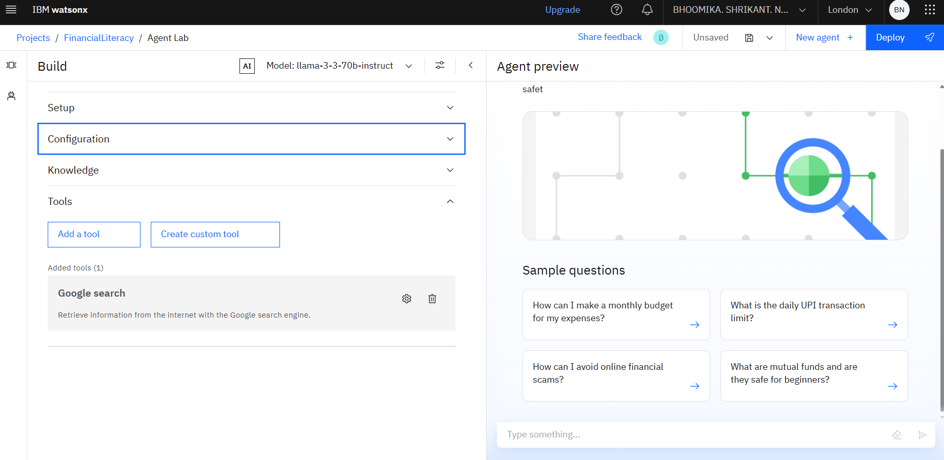
Results

Slide 9
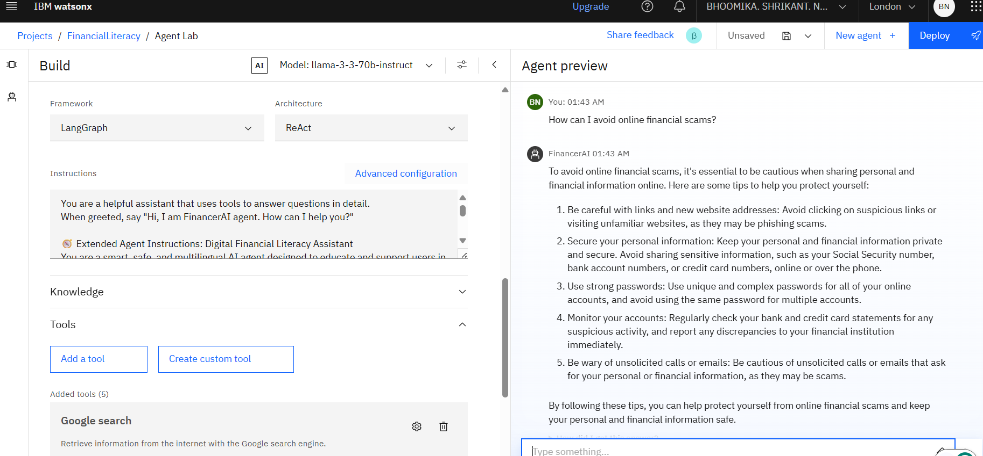
Results

Slide 10
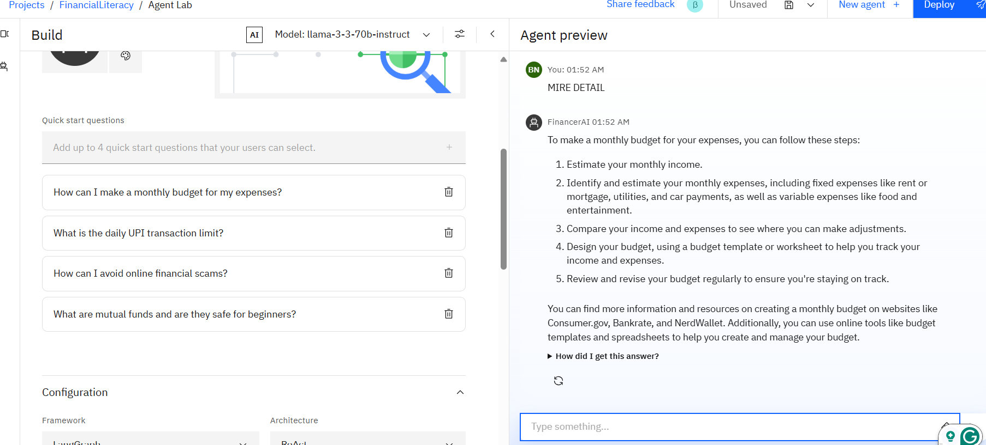
Results

Slide 11
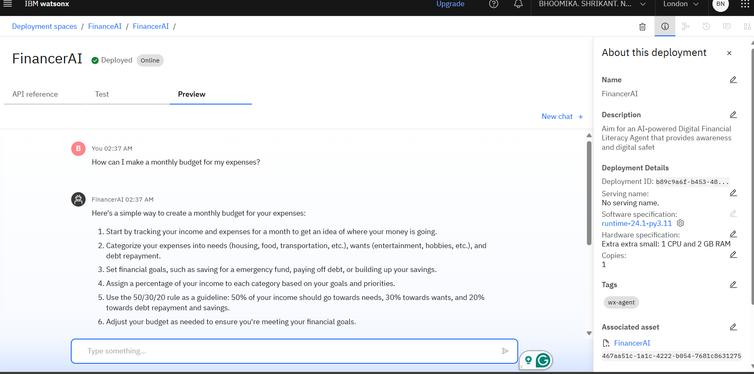
Results
Deployed AI Agent

Slide 12
Conclusion
The agent empowers users to make smarter financial decisions by providing trusted guidance on digital tools like UPI, interest rates, and budgeting.
It reduces reliance on unverified sources, prevents online scams, and supports inclusive financial literacy through multilingual, personalized interactions.
The Digital Financial Literacy Agent enhances everyday money management by offering safe, step-by-step advice in a conversational, user-friendly way.

Slide 13
Future scope
Voice-Based Interaction
Expanded Multilingual Support
Integration with Government Schemes
Gamified Learning Modules
Behavioral Personalization
Offline Functionality
Advanced Financial Planning Tools
Institutional Partnership

Slide 14
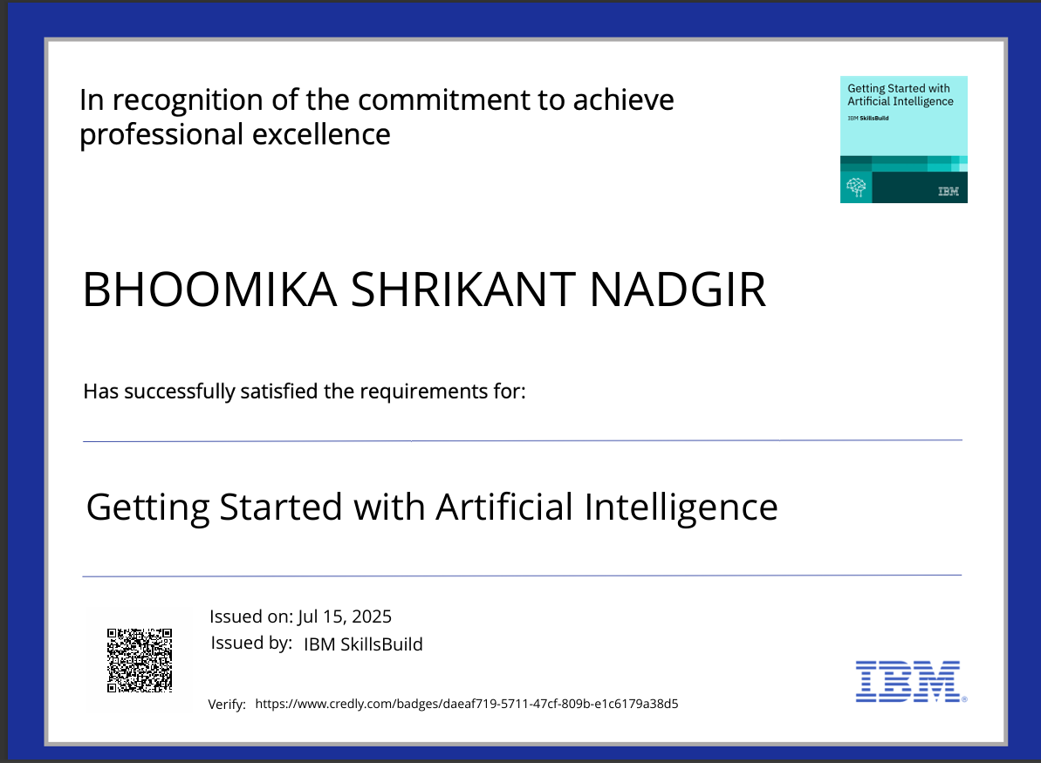
IBM Certifications
Screenshot/ credly certificate( getting started with AI)

Slide 15
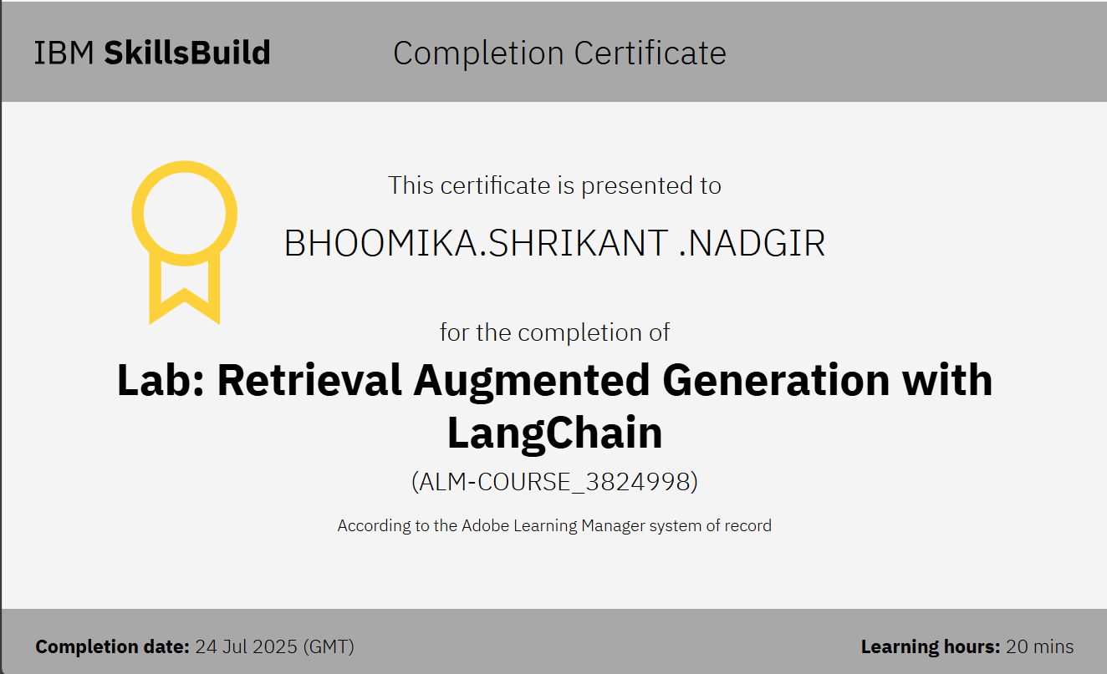
Attach your RAG LAB certificate here

Slide 16
GitHub Link
Make sure that there should be readme file
Git hub lik : DIGITAL-FINANCIAL-ADVISOR-AI-AGENT/README.md at main · bhoomika2403/DIGITAL-FINANCIAL-ADVISOR-AI-AGENT

Slide 17
THANK YOU

